Slide 1

System Design & Analysis
PHASE FINAL
5.8.2024

Slide 2

Meet the team
PROJECT MANAGER
Adria Gratiot
PROGRAMMER
Matt Neiner
PROGRAMMER
Carl Samuels
PROGRAMMER
Timothy Huffman

Slide 3
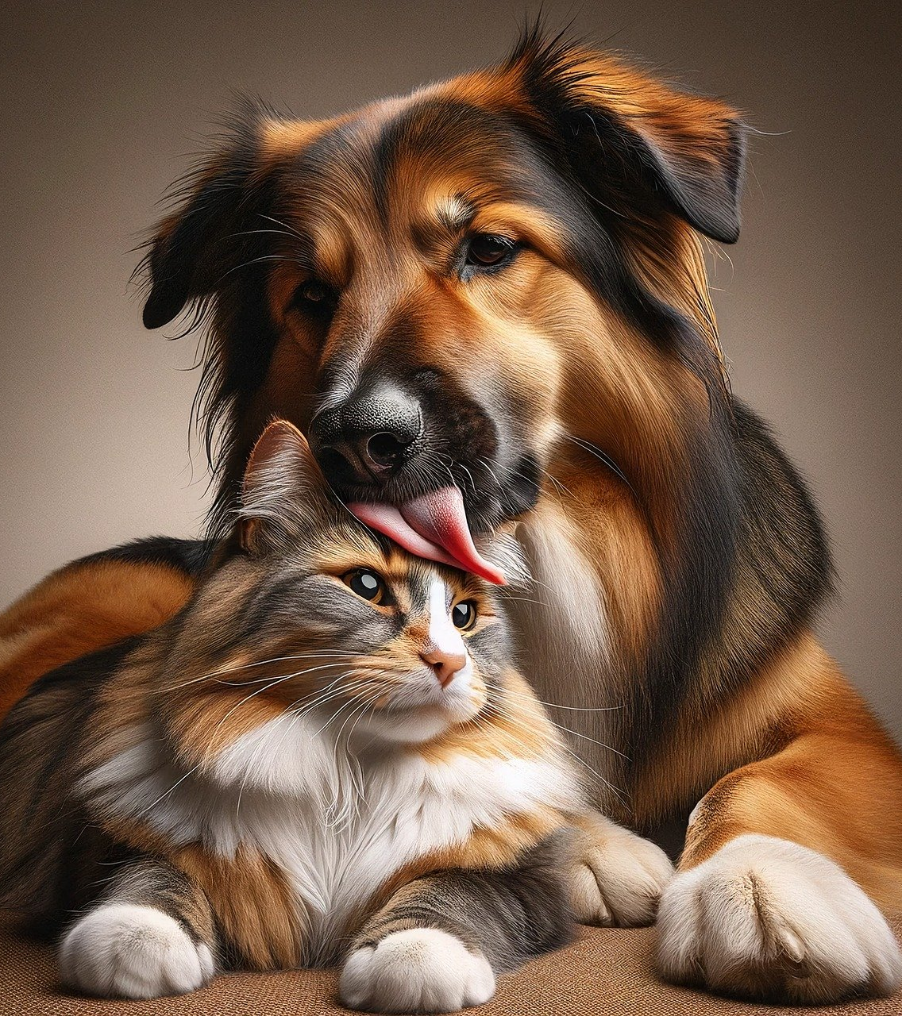
“We’re not to blame for your pet’s bad name”
PET NAMER
Would you like help picking
a name for your pet?
Simply upload a picture and
we’ll recommend a few
different names for you!
*Cats, Dogs, Birds, snakes, Hamsters, and Cows

Slide 4
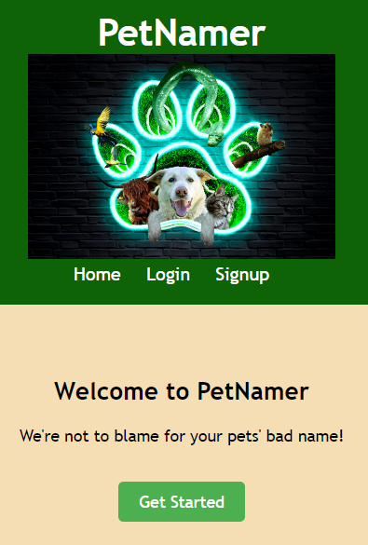
Interface: landing page
When a pet owner IS NOT logged in, this is the home page.
Navigation bar links:
Home (current page)
Login (must already have an account)
Signup (create new account)
Page link:
Get Started (goes to login page)

Slide 5
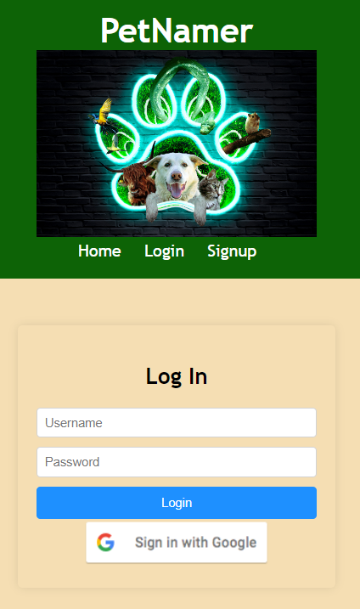
Interface: login page
Navigation bar links:
Home (landing page)
Login (current page, must already have an account)
Signup (create new account)
Page links:
Login (when a pet owner already has an account)
Sign in with Google (a pet owner can use their Google account to log in)

Slide 6
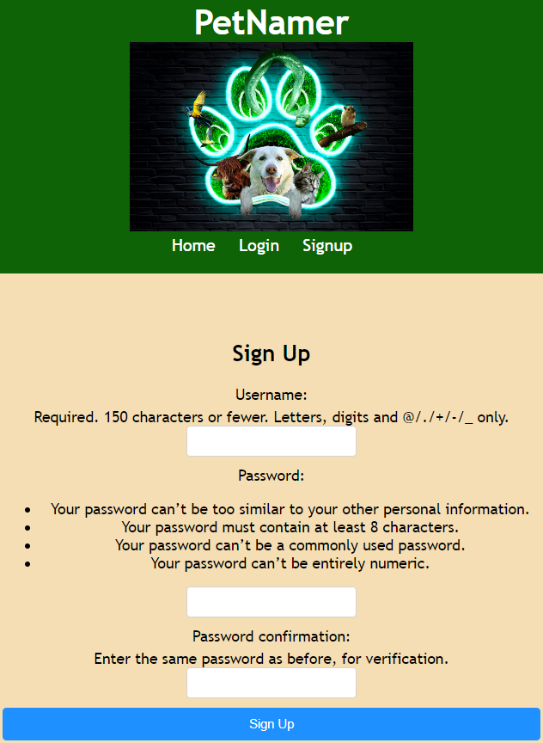
Interface: signup page
Navigation bar links:
Home (landing page)
Login (current page, must already have an account)
Signup (current page)
Page link:
Sign Up (completes account creation, goes to the login screen)

Slide 7
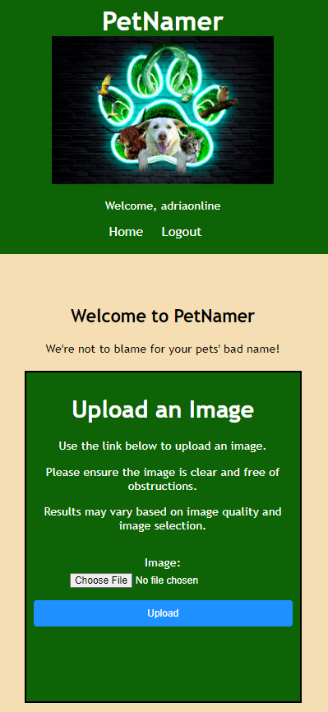
Interface: upload image (home)
When a pet owner IS logged in, this is the home page.
Navigation bar links:
Home (landing page)
Logout (returns to the landing page)
Page links:
Choose File (opens local file system)
Upload (uploads file after one is selected)

Slide 8
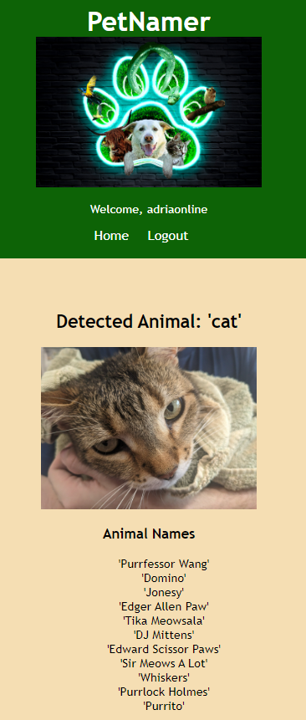
Interface: Pet name suggestions
Navigation bar links:
Home (landing page)
Logout (returns to the landing page)
Page links:
None

Slide 9
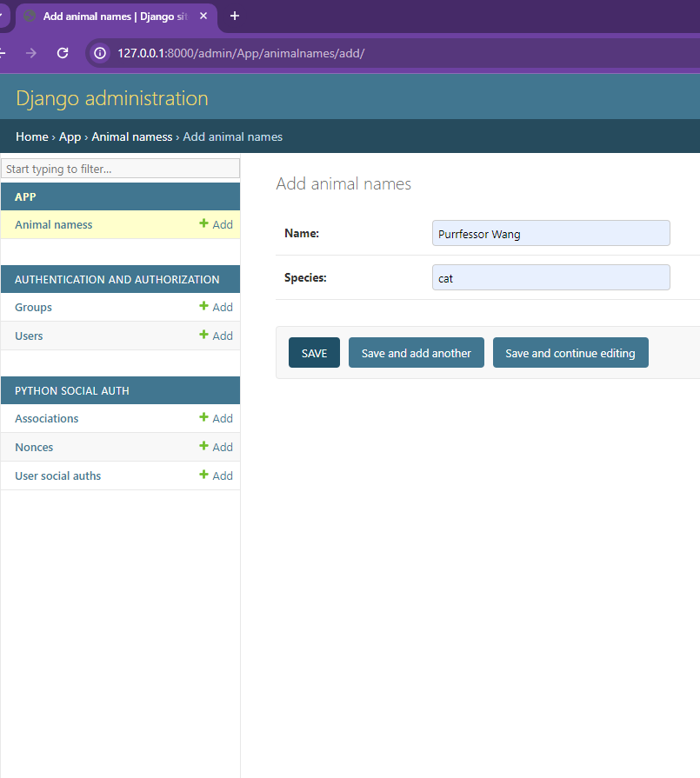
database
The Django framework includes SQL database management accessible through the administrative section of the website. We set up an animal name database with the species and names for the Azure image recognition API to reference. There are six species for Azure to reference:
cat, dog, bird, snake, hamster, cow

Slide 10
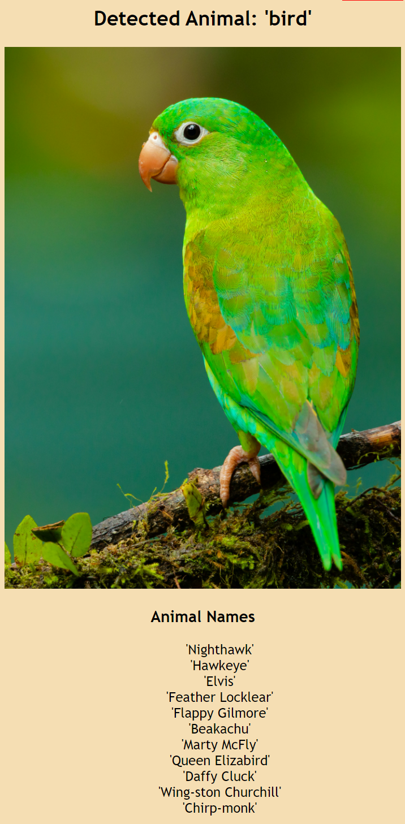
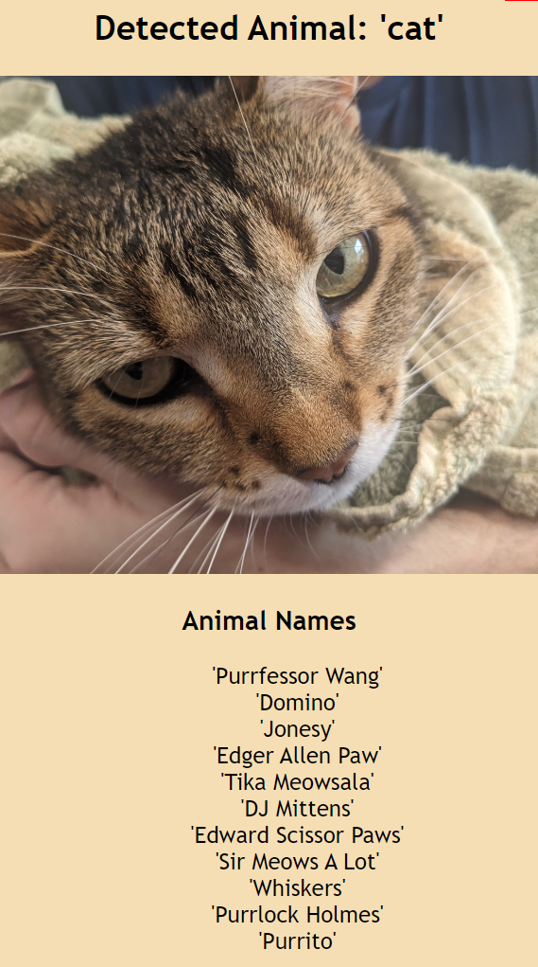
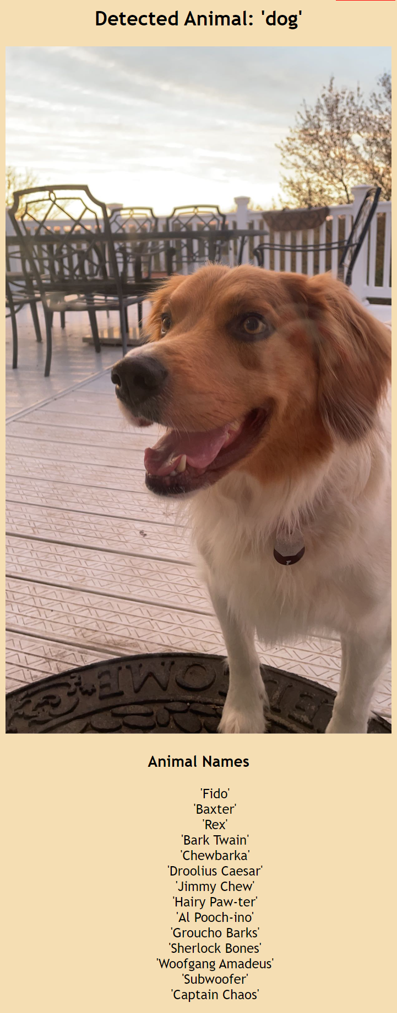
Output Name suggestions: cat, dog, bird

Slide 11
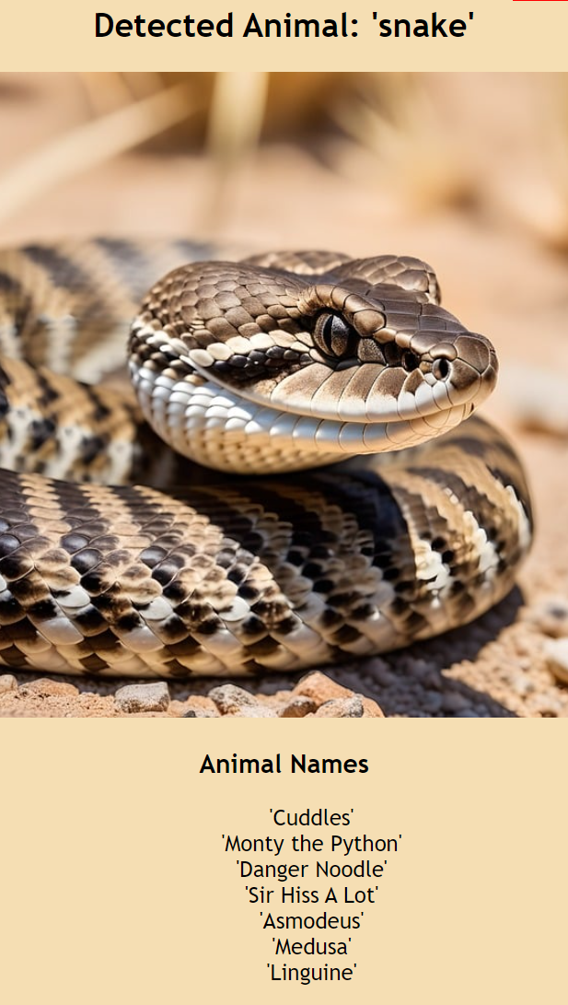
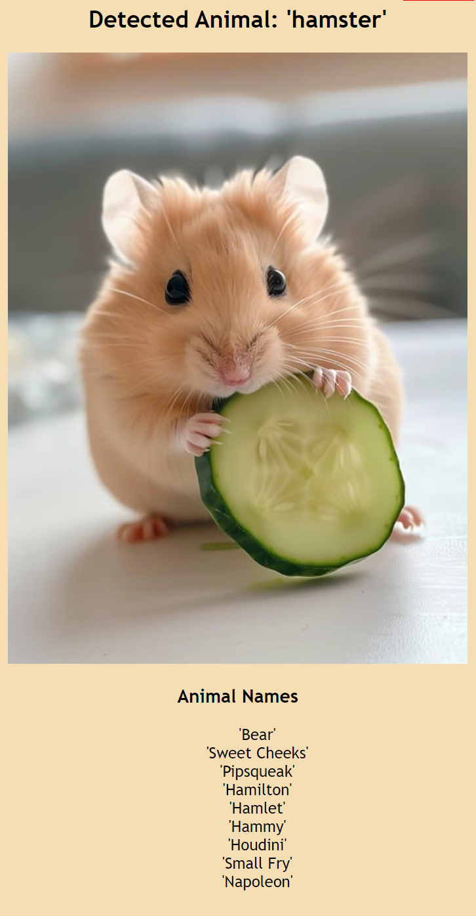
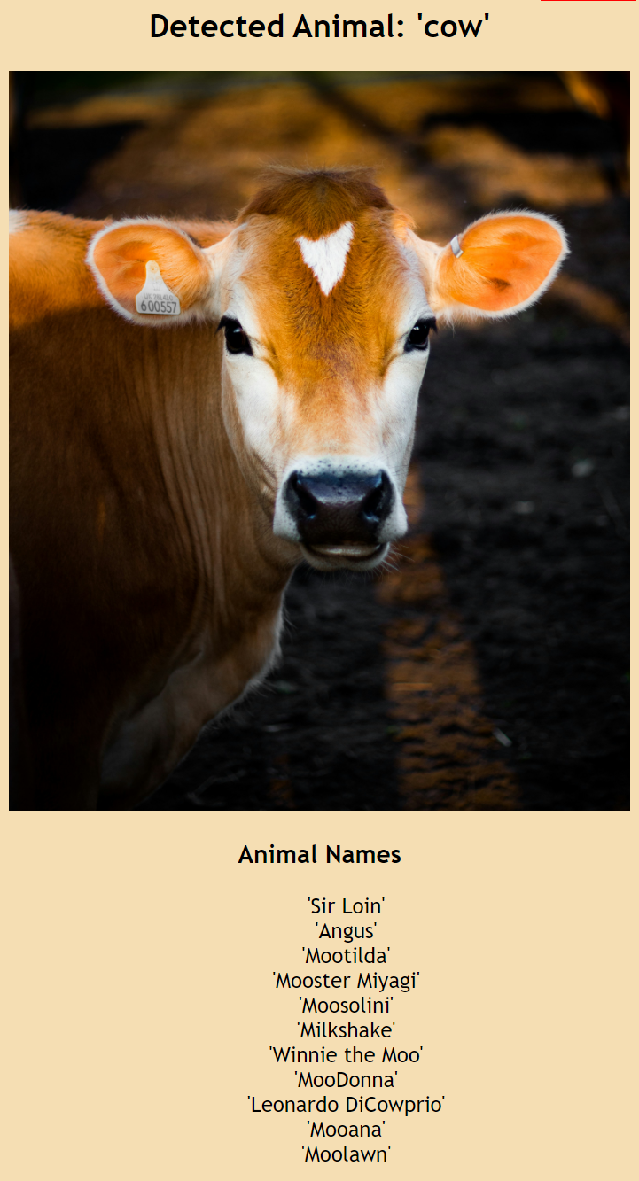
Output Name suggestions: snake, hamster, cow

Slide 12

Technology: hardware & software
Local Host Laptop/Desktop
Local Host Router
VSCode IDE
Django (includes SQL database)
Python 3.11.8
Google Authentication API
Azure Image Recognition AI API

Slide 13
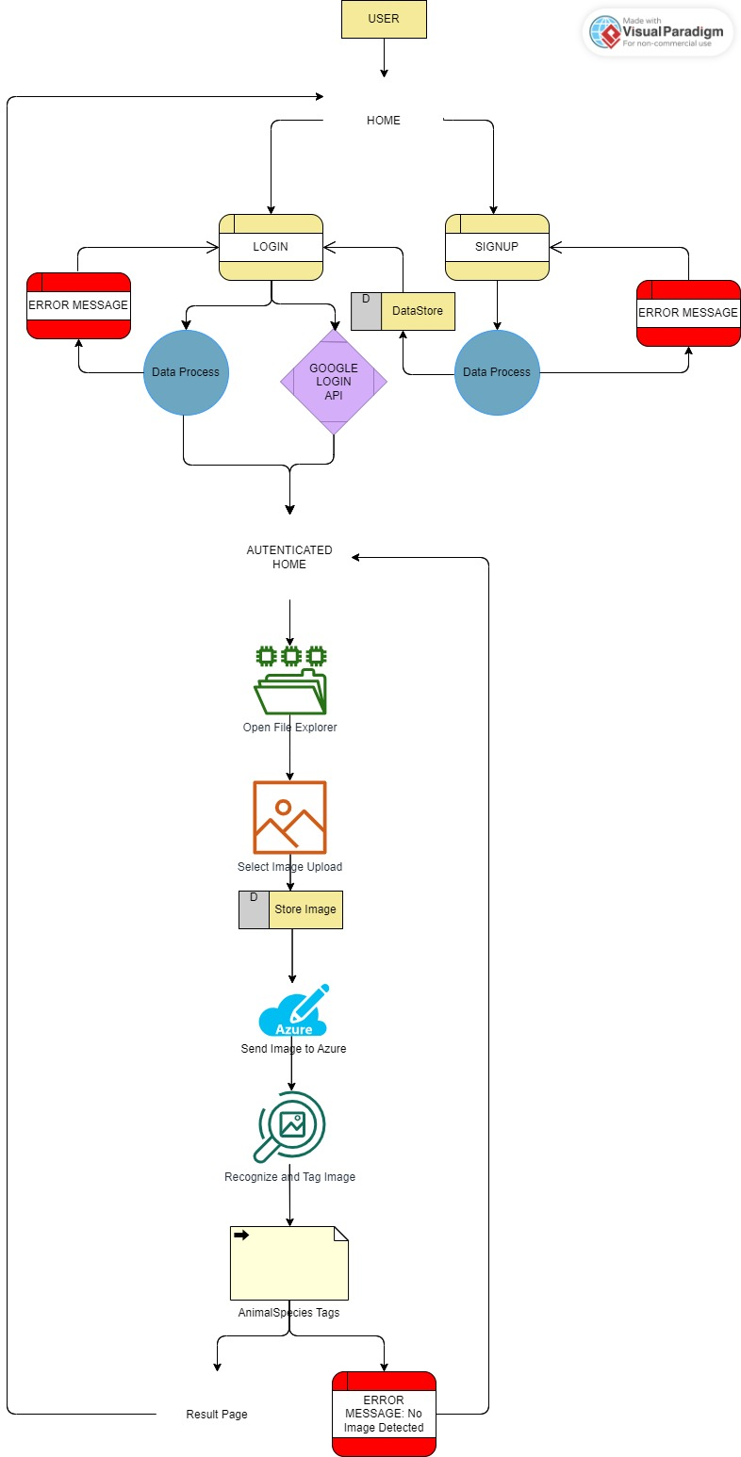
Data flow

Slide 14
LIVE demo
Team 1: Final Presentation

